Slide 1
Tableau Module 3
Data Analytics

Slide 2


























Common Charts
Data Views
Hierarchies
Data Structures
Basic Navigation
Dashboards
You are here
Data Stories
Calculations
Advanced
Charts
Certification Springs
Blending
Done

Slide 3
Module 3 Learning Outcomes
Demonstrate how to create a hierarchy
Demonstrate creating groups and sets
Understand custom parameters
Understand date/time in Tableau

Slide 4

Hierarchies Everywhere!

Slide 5
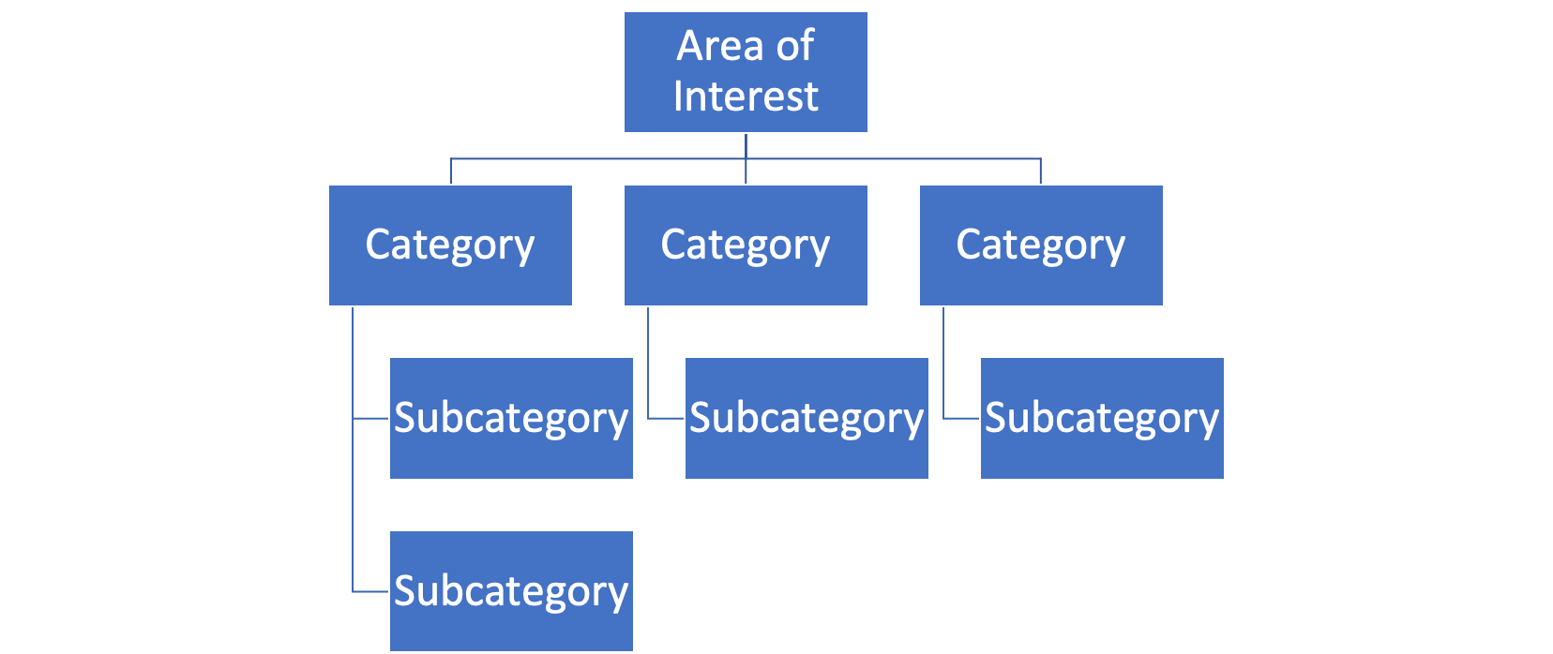
Hierarchies

Slide 6
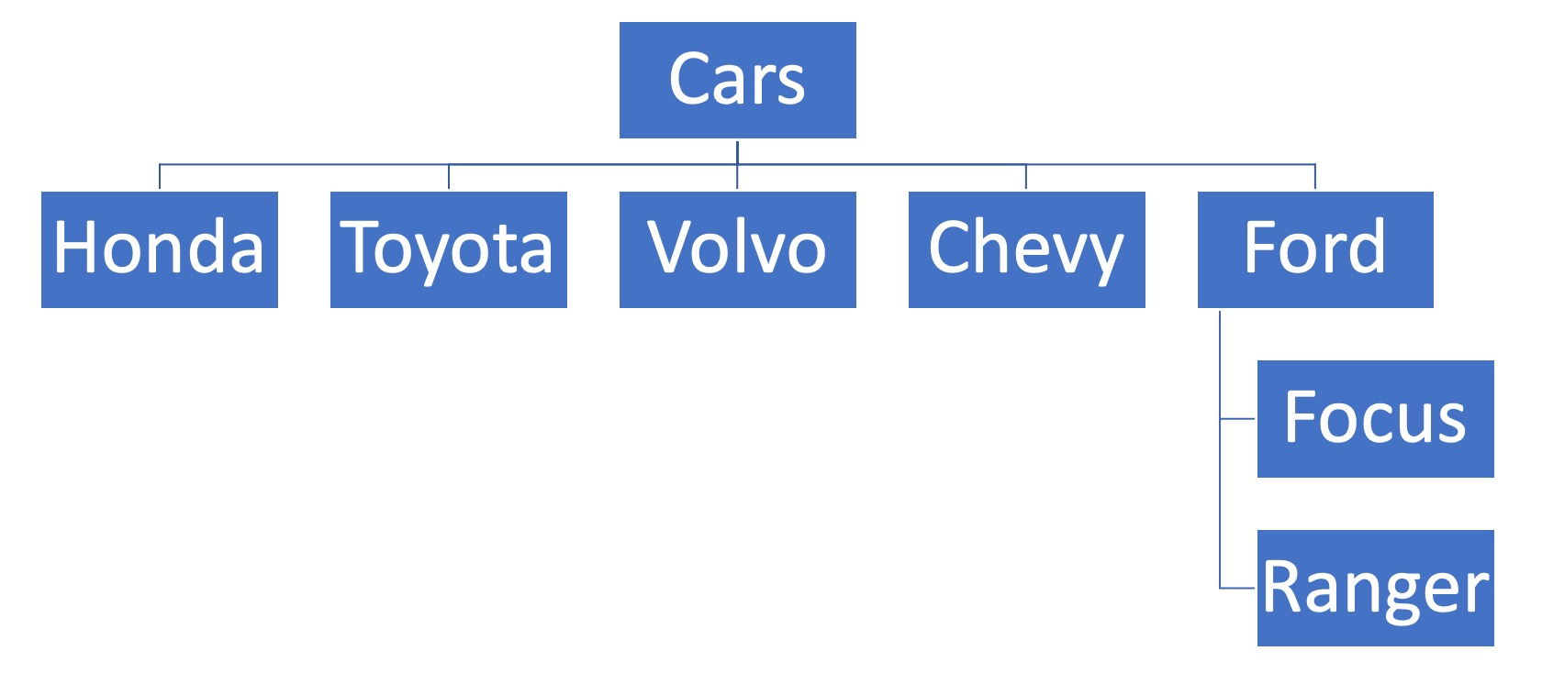
Car Hierarchy

Slide 7
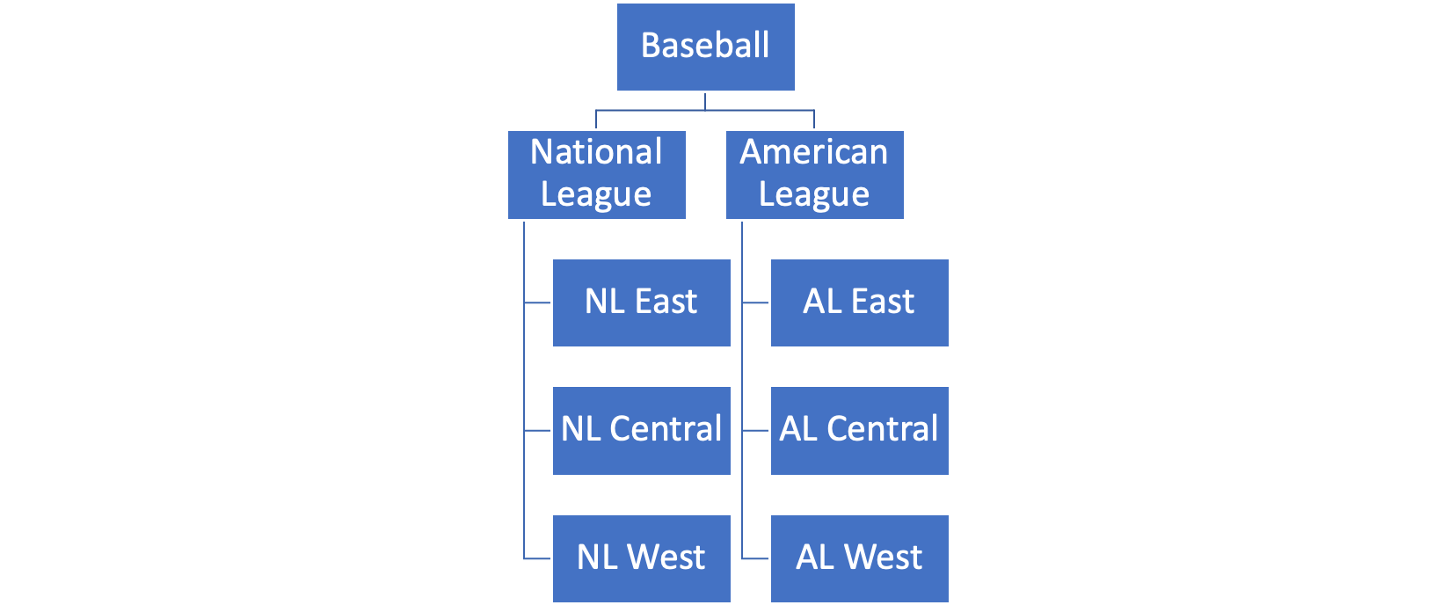
Sports Hierarchy

Slide 8
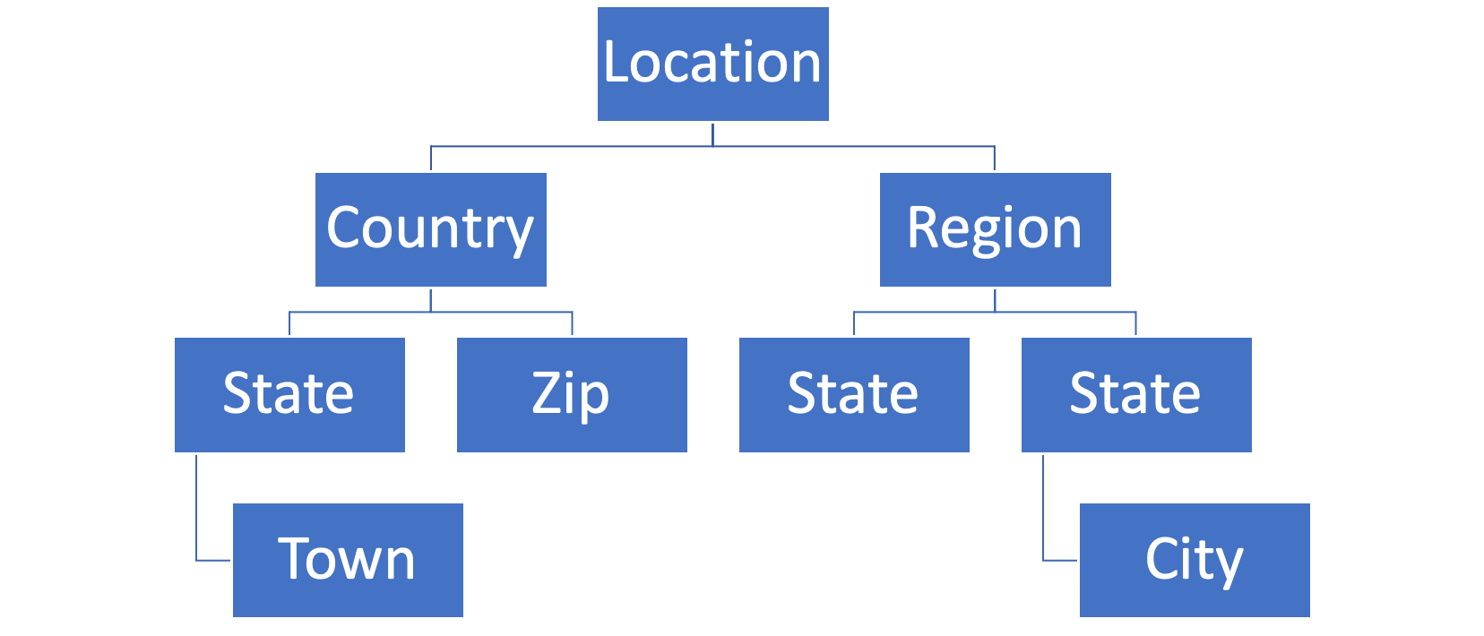
Location Hierarchies

Slide 9
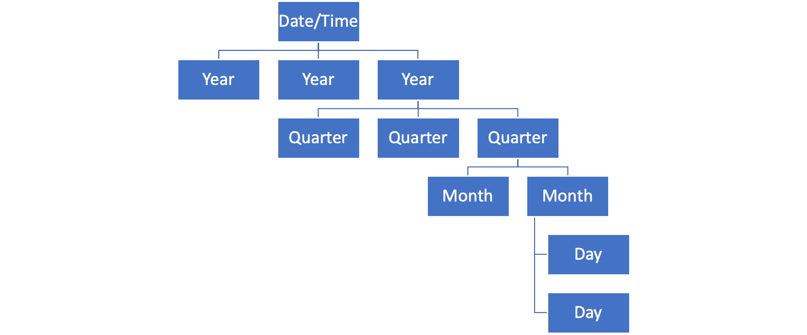
Date/Time Hierarchy

Slide 10
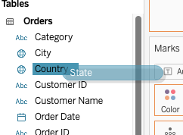

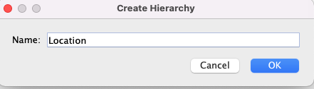
Creating Hierarchies

Slide 11
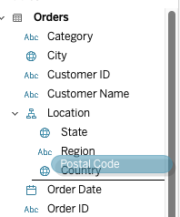
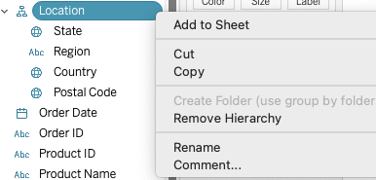
Editing Hierarchies
Drag and drop new elements
into existing hierarchies
Arrange from top to bottom
to specify order for ‘drill down’
Remove or rename a hierarchy

Slide 12
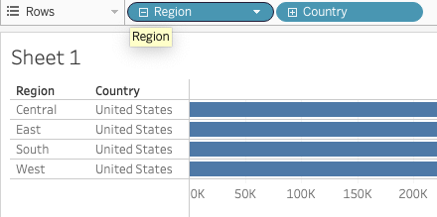
Drilling Down Into Hierarchies
Use + or - to expand or collapse a hierarchy

Slide 13
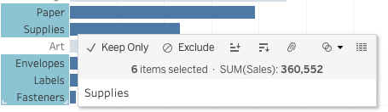
Creating Groups
You can create new groups to simplify complex structures
The paper clip designates groups

Slide 14
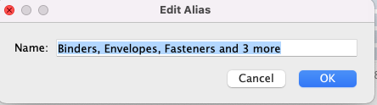
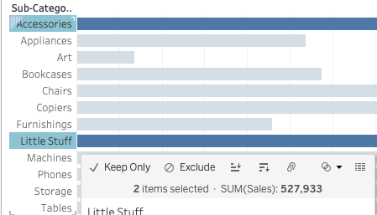
Updating Groups
The group can be renamed or given an ‘alias’
You can add more items to the group.
Tableau knows what you’re up to.

Slide 15
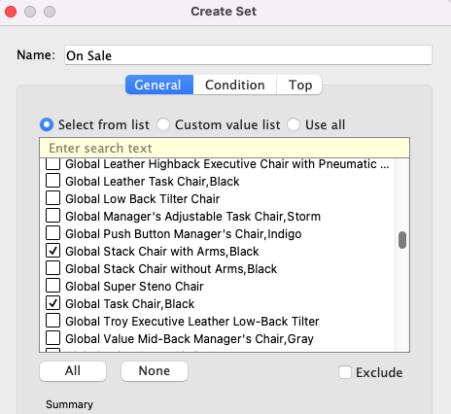
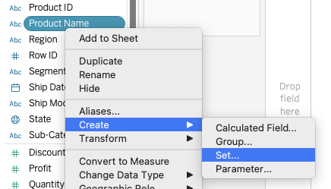
Creating Sets
Sets designate a special status.
Elements are either in or out of the set.
Useful with color coding

Slide 16
Parameters and Dates in Tableau

Slide 17
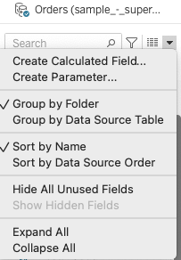
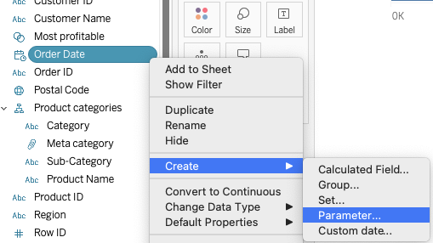
Parameters are Variables
You can define parameters under “view data”
Or you can derive them from existing data

Slide 18
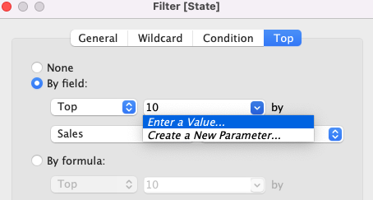
Parameters for Filtering
You can define a parameter to make filters more dynamic

Slide 19
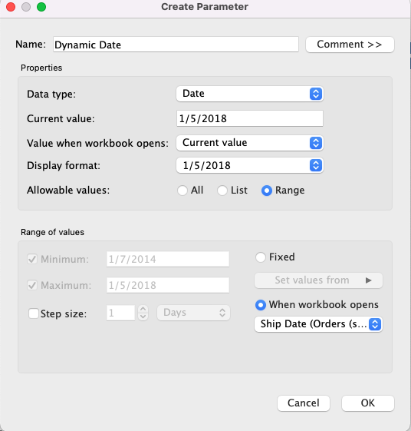
Dynamic Parameters*
*New feature in 2021

Slide 20
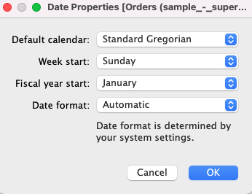
Dates in Tableau

Slide 21
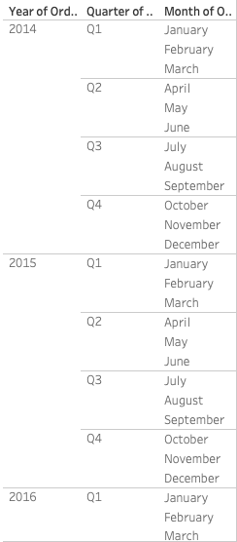
Date Hierarchy in Tableau
Dates (and times) form a natural
(built in) hierarchy in Tableau

Slide 22
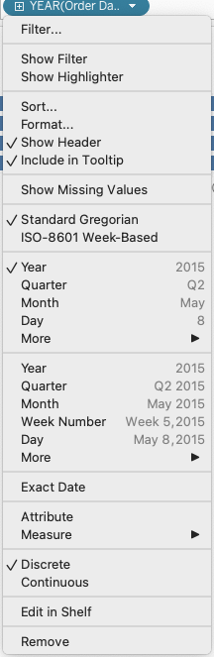
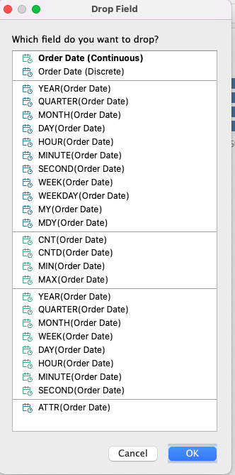
Discrete/Continuous
Dates in Tableau
Discrete time
Continuous time

Slide 23
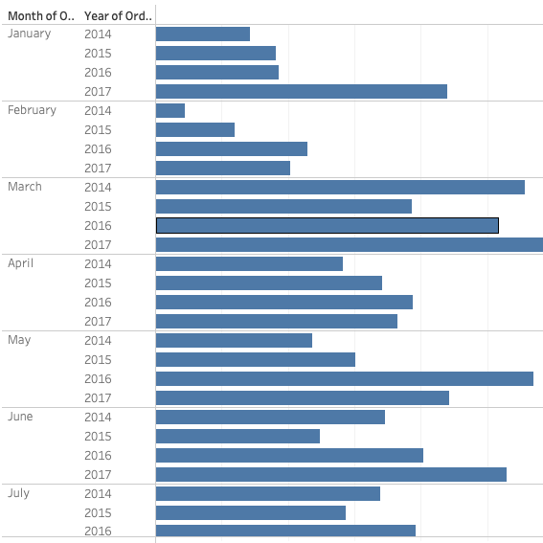
Discrete Dates in Tableau
Discrete dates can
be rearranged for a
‘year-over-year’
analysis

Slide 24
Mini Challenge:
Use ‘baseball2015-2019.csv’
Create a hierarchy for TeamID and LgID and call it ‘Leagues’
Create groups for NL East and AL East
Create a Set for World Series Winners

Slide 25
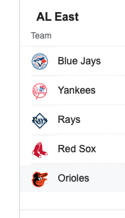
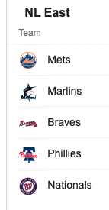
Baseball Groups
TOR
NYA
TBA
BOS
BAL
NYN
MIA
ATL
PHI
WAS

Slide 26
World Series Winners Set
2019 Washington Nationals
2018 Boston Red Sox
2017 Houston Astros
2016 Chicago Cubs
2015 Kansas City Royals

